Slide 1
26
Servlets

Slide 2
A fair request should be followed by the deed in silence.
  Dante Alighieri
The longest part of the journey is said to be the passing of the gate.
  Marcus Terentius Varro
If nominated, I will not accept; if elected, I will not serve.
  General William T. Sherman
Friends share all things.
  Pythagoras

Slide 3
OBJECTIVES
In this chapter you will learn:
How servlets can be used to extend a Web server's functionality.
The servlet life cycle.
To execute servlets with the Apache Tomcat server.
To be able to respond to HTTP requests from an HttpServlet.
To be able to redirect requests to static and dynamic Web resources.
To use JDBC from a servlet.

Slide 4
26.1 Introduction
26.2 Servlet Overview and Architecture
  26.2.1 Interface Servlet and the Servlet Life Cycle
  26.2.2 HttpServlet Class
  26.2.3 HttpServletRequest Interface
  26.2.4 HttpServletResponse Interface
26.3 Setting Up the Apache Tomcat Server
26.4 Handling HTTP get Requests
26.4.1 Deploying a Web Application
26.5 Handling HTTP get Requests Containing Data
26.6 Handling HTTP post Requests
26.7 Redirecting Requests to Other Resources
26.8 Multitier Applications: Using JDBC from a Servlet
26.9 Welcome Files
26.10 Wrap-Up
26.11 Internet and Web Resources

Slide 5
26.1 Introduction
Java networking capabilities
  Socket-based and packet-based communications
    Package java.net
  Remote Method Invocation (RMI)
    Package java.rmi
  Common Object Request Broker Architecture (COBRA)
    Package org.omg
  Remote Method Invocation over the Internet Inter-Orb Protocol (RMI-IIOP)

Slide 6
26.1 Introduction (Cont.)
Client-server relationship
  Servlets and JavaServer Pages (JSP)
    Request-response model
    Packages javax.servlet
        javax.servlet.http
        javax.servlet.jsp
        javax.servlet.tagext
    Common implementation of request-response model
      Web browsers and Web servers
    Form the Web components of J2EE

Slide 7
26.1 Introduction (Cont.)
Thin clients
  Provide presentation
  Do not process data
  Require fewer computing resources

Slide 8
26.1 Introduction (Cont.)
Apache Jakarta Project and the Tomcat Server
Tomcat
  Jakarta project
  Official reference implementation of the JSP and servlet standards

Slide 9
26.2 Servlet Overview and Architecture
Servlet
  Small portion of the content is static text or markup
  Do not produce content
  Perform a task on behalf of the client
JavaServer Pages
  Extension of servlet technology
  Most of the content is static text or markup
  Small portion of the content is generated dynamically
Servlet container (servlet engine)
  Server that executes a servlet

Slide 10
26.2 Servlet Overview and Architecture (Cont.)
Web servers and application servers
  Sun Java System Application Server
  Microsoft’s Internet Information Server (IIS)
  Apache HTTP Server
  BEA’s WebLogic Application Server
  IBM’s WebSphere Application Server
  World Wide Web Consortium’s Jigsaw Web Server

Slide 11
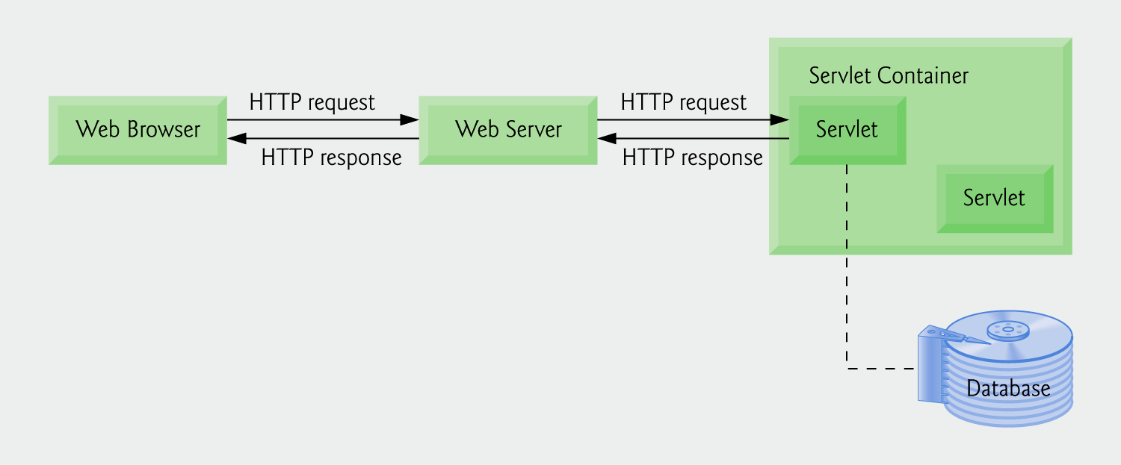
Fig. 26.1 | Servlet architecture.

Slide 12
26.2.1 Interface Servlet and the Servlet Life Cycle
Interface Servlet
  All servlets must implement this interface
  All methods of interface Servlet are invoked by servlet container
Servlet life cycle
  Servlet container invokes the servlet’s init method
  Servlet’s service method handles requests
  Servlet’s destroy method releases servlet resources when the servlet container terminates the servlet
Servlet implementation
  GenericServlet
  HttpServlet

Slide 13
Software Engineering Observation 26.1
Servlets implement the Servlet interface of package javax.servlet.

Slide 14
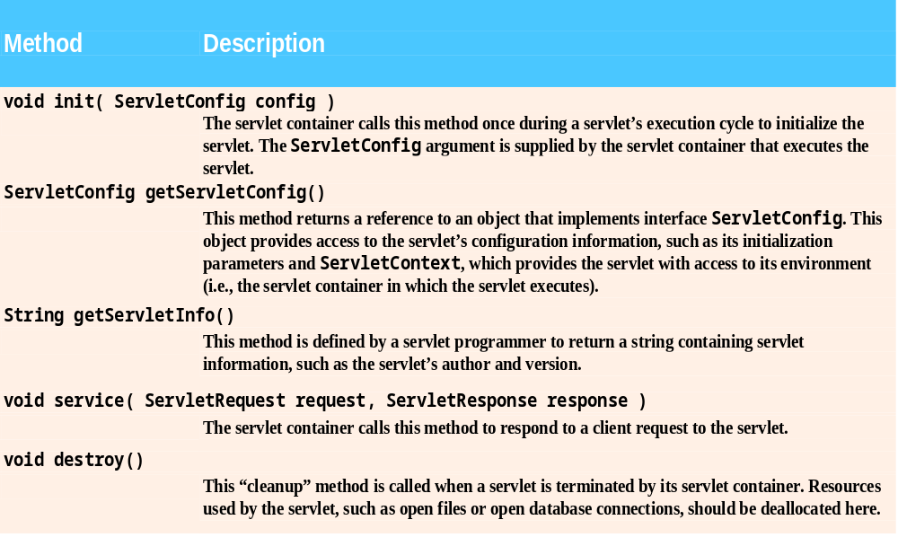
Fig. 26.2 | Servlet interface methods.

Slide 15
26.2.1 Interface Servlet and the Servlet Life Cycle (Cont.)
Interface Servlet implementation
  GenericServlet
    Abstract class
    Package javax.servlet
    Protocol-independent servlet
  HttpServlet
    Abstract class
    Package javax.servlet.http
    Use the HTTP protocol to exchange information
    Key method service
      ServletRequest and ServletResponse

Slide 16
26.2.2 HttpServlet Class
Overrides method service
Two most common HTTP request types
  get requests
    Get/retrieve information from server
  post requests
    Post/send data to server
Method doGet responds to get requests
Method doPost responds to post requests
HttpServletRequest and HttpServletResponse objects

Slide 17
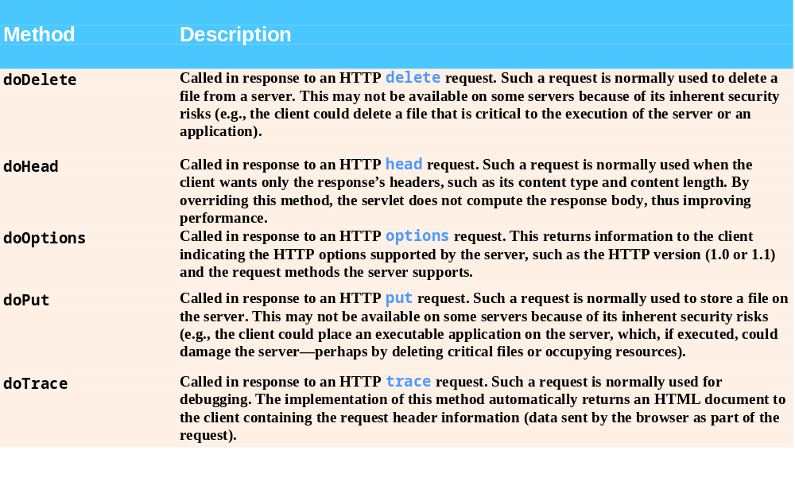
Fig. 26.3 | HttpServlet class’s other methods.

Slide 18
Software Engineering Observation 26.2
Do not override method service in an HttpServlet subclass. Doing so prevents the servlet from distinguishing between request types.

Slide 19
26.2.3 HttpServletRequest Interface
Servlet container
  creates an HttpServletRequest object
  passes it to the servlet’s service method
HttpServletRequest object
  contains the request from the client
  provides methods that enable the servlet to process the request

Slide 20
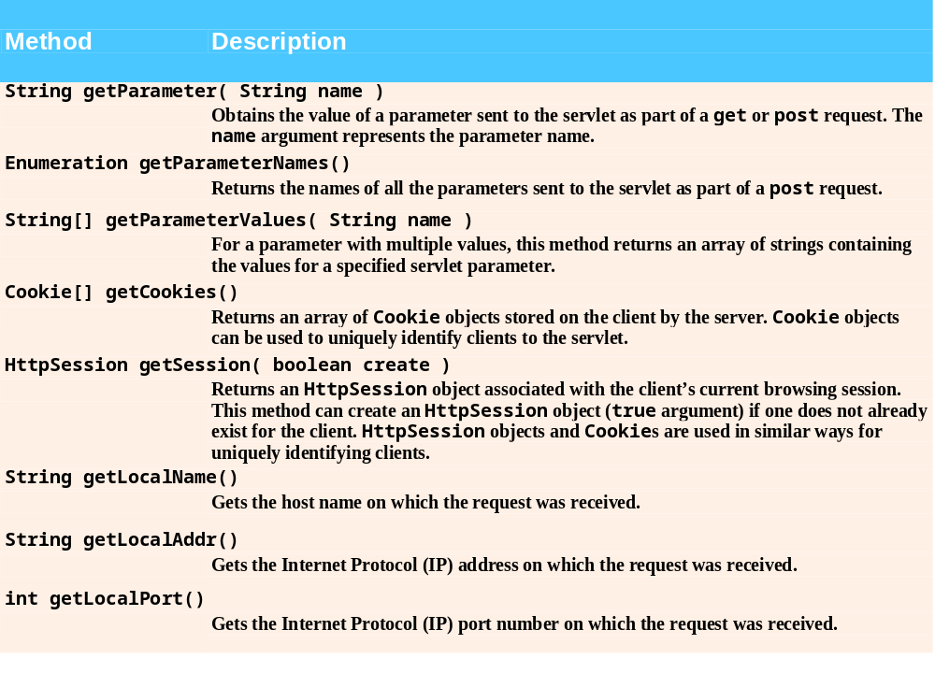
Fig. 26.4 | HttpServletRequest methods.

Slide 21
26.2.4 HttpServletResponse Interface
Servlet container
  creates an HttpServletResponse object
  passes it to the servlet’s service method
HttpServletResponse object
  provides methods that enable the servlet to formulate the response to the client

Slide 22
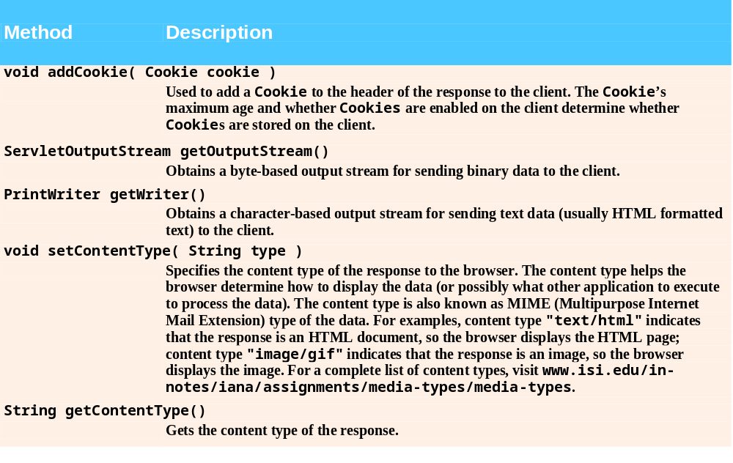
Fig. 26.5 | HttpServletResponse methods.

Slide 23
26.3 Setting Up the Apache Tomcat Server
Download Tomcat (version 5.0.25)
  apache.towardex.com/jakarta/
  tomcat-5/v5.0.25/bin
Define environment variables
  JAVA_HOME
    C:\Program Files\Java\jdk1.5.0
  CATALINA_HOME
    C:\jakarta-tomcat-5.-.25

Slide 24
Error-Prevention Tip 26.1
On some platforms you may need to restart your computer for the new environment variables to take effect

Slide 25
26.3 Setting Up the Apache Tomcat Server (Cont.)
Start the Tomcat server
  startup
Launch the Tomcat server
  http://localhost:8080/
Shutdown the Tomcat server
  shutdown

Slide 26
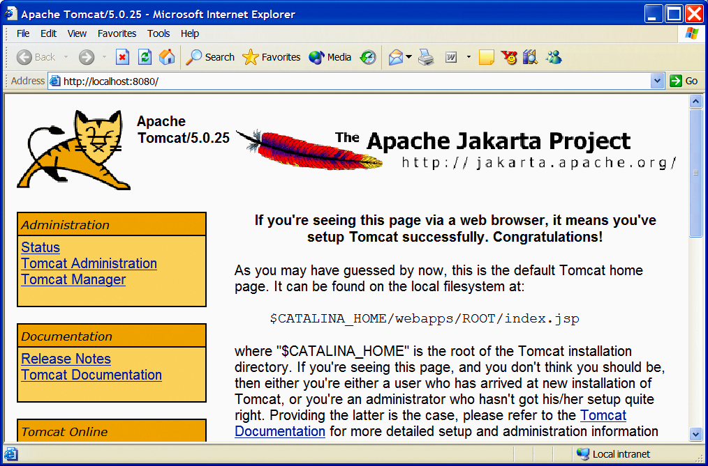
Fig. 26.6 | Tomcat documentation home page. Copyright 2000-2004 The Apache Software Foundation (http://www.apache.org/). All rights reserved.

Slide 27
Error-Prevention Tip 26.2
If the host name localhost does not work on your computer, substitute the IP address 127.0.0.1 instead.

Slide 28
26.4 Handling HTTP get Requests
get request
  Retrieve the content of a URL
Example: WelcomeServlet
  a servlet handles HTTP get requests

Slide 29
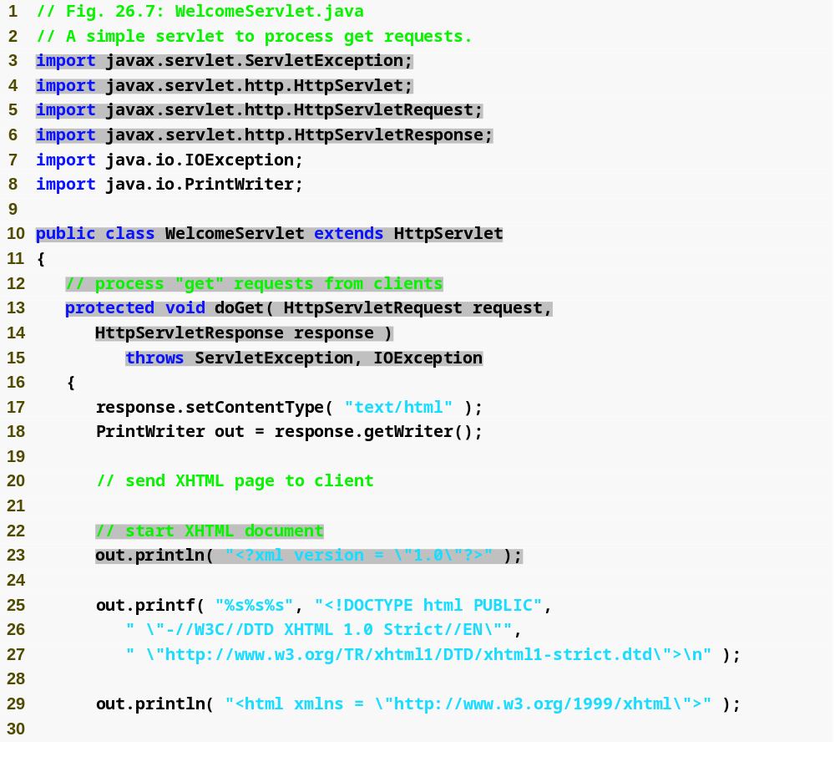
Outline
Import the classes and interfaces in the javax.servlet and javax.servlet.http packages
WelcomeServlet.java
  (1 of 2)
  Lines 3-6
  Line 10
  Lines 13-44
  Line 17
  Line 18
  Line 23
Extends HttpServlet to handle HTTP get requests and HTTP post requests
Override method doGet to provide custom get request processing
Uses the response object’s setContentType method to specify the content type of the data to be sent as the response to the client
Uses the response object’s getWriter method to obtain a reference to the PrintWriter object that enables the servlet to send content to the client
Create the XHTML document by writing strings with the out object’s println method

Slide 30
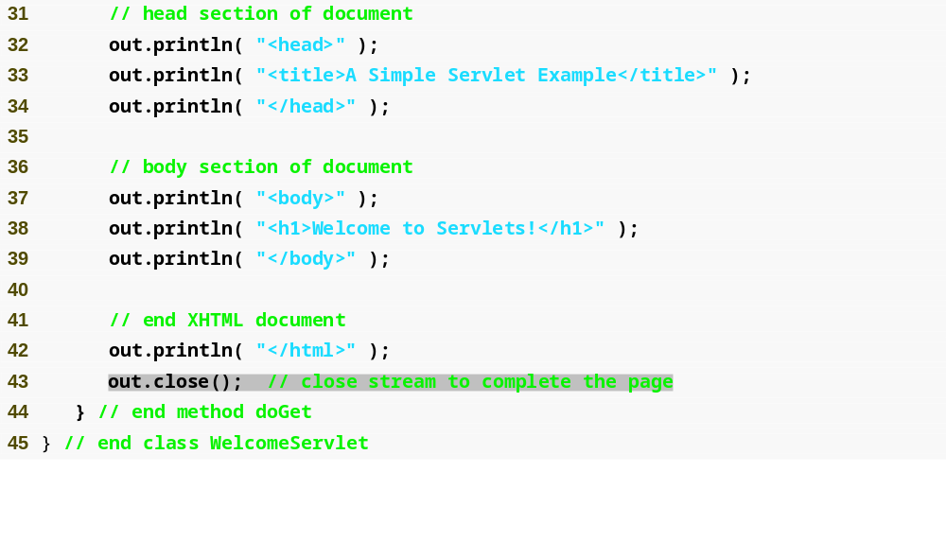
Outline
WelcomeServlet.java
  (2 of 2)
  Line 43
Closes the output stream, flushes the output buffer and sends the information to the client

Slide 31
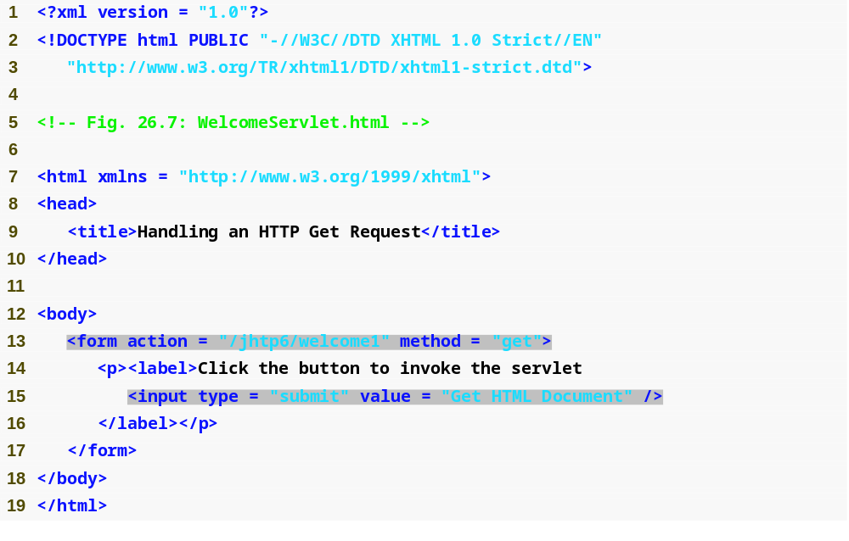
Outline
WelcomeServlet.html
  (1 of 2)
  Line 13
  Line 13
  Line 15
The form’s action attribute (/jhtp6/welcome1) specifies the URL path that invokes the servlet
The form’s method attribute indicates that the browser sends a get request to the server, which results a call to the servlet’s doGet method
Create a button, when clicked, the form’s action is performed

Slide 32

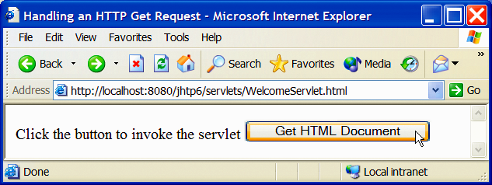
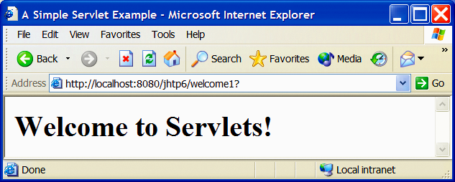
Outline
WelcomeServlet.html
  (2 of 2)
  Program output

Slide 33
Software Engineering Observation 26.3
The Tomcat documentation specifies how to integrate Tomcat with popular Web server applications such as the Apache HTTP Server and Microsoft’s IIS.

Slide 34
Common Programming Error 26.1
Using “servlet” or “servlets” as a context root may prevent a servlet from working correctly on some servers.

Slide 35
26.4.1 Deploying a Web Application
Web applications
  JSPs, servlets and their supporting files
Deploying a Web application
  Directory structure
    Context root
  Web application archive file (WAR file)
  Deployment descriptor
    web.xml

Slide 36
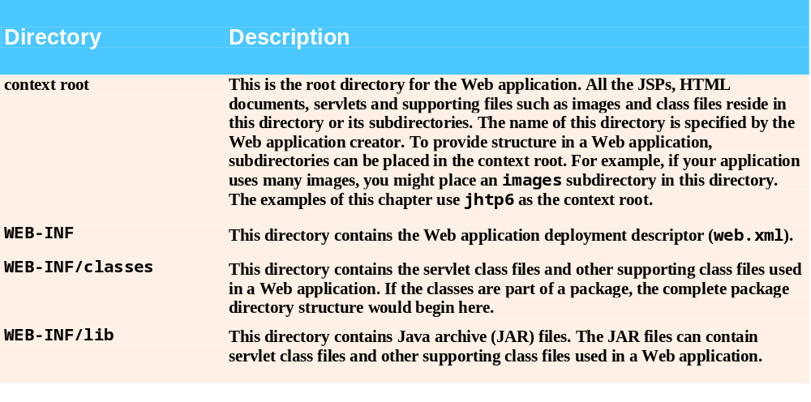
Fig. 26.9 | Web application standard directories.

Slide 37
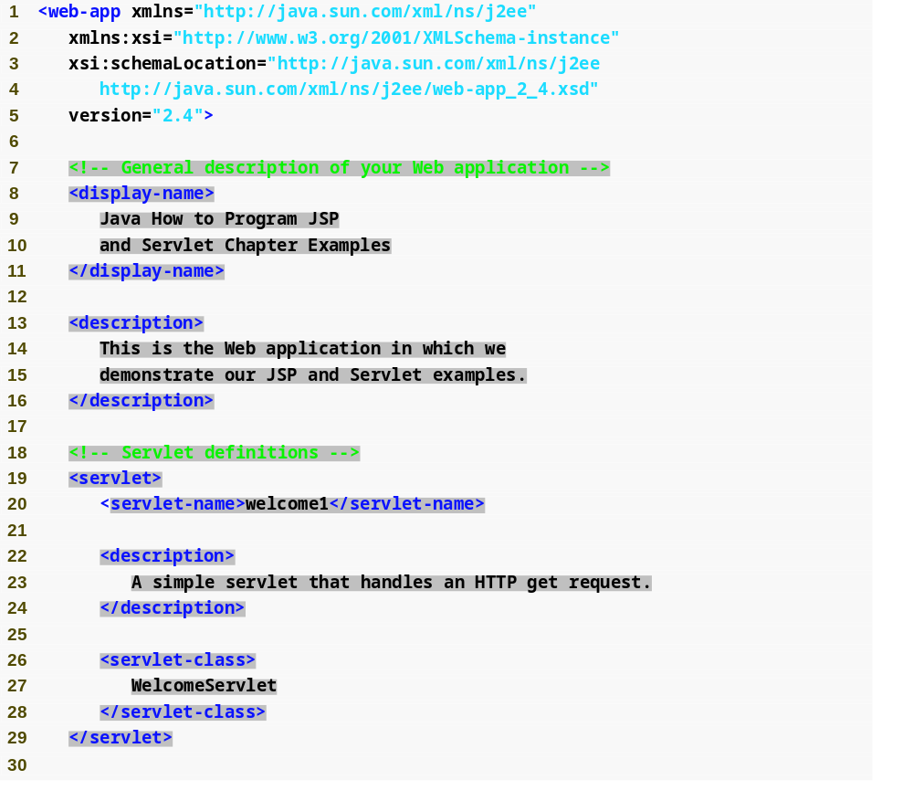
Outline
Element display-name specifies a name that can be displayed to the administrator of the server on which the Web application is installed.
Web.xml
  (1 of 2)
  Lines 1-37
  Lines 8-11
  Lines 13-16
  Lines 19-29
  Line 20
  Lines 22-24
  Lines 26-28
Element web-app defines the configuration of each servlet in the Web application and the servlet mapping for each servlet.
Element description specifies a description of the Web application that might be displayed to the administrator of the server.
Element servlet describes a servlet.
Element servlet-name is the name for the servlet.
Element description specifies a description for this particular servlet.
Element servlet-class specifies compiled servlet’s fully qualified class name.

Slide 38
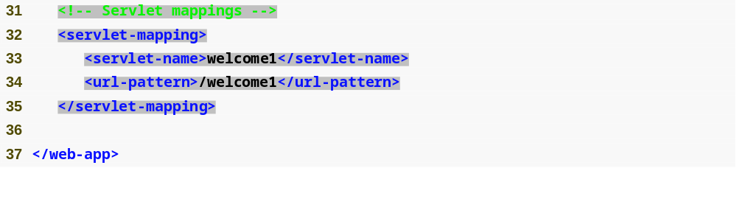
Outline
Element servlet-mapping specifies servlet-name and url-pattern elements.
Element url-pattern helps the server determine which requests are sent to the servlet
Web.xml
  (2 of 2)
  Lines 32-35
  Line 34

Slide 39
26.4.1 Deploying a Web Application (Cont.)
Invoke WelcomeServlet example
  /jhtp6/welcome1
    /jhtp6 specifies the context root
    /welcome1 specifies the URL pattern
URL pattern formats
  Exact match
    /jhtp5/welcome1
  Path mappings
    /jhtp5/example/*
  Extension mappings
    *.jsp
  Default servlet
    /

Slide 40
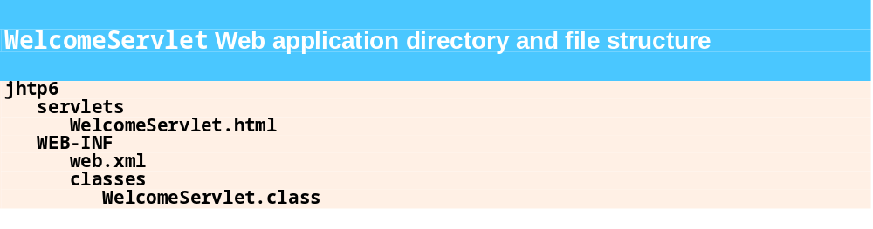
Fig. 26.11 | Web application directory and file structure for WelcomeServlet.

Slide 41
Common Programming Error 26.2
Not placing a servlet or other class files in the appropriate directory structure prevents the server from locating those classes properly. This results in an error response to the client Web browser.

Slide 42
Error-Prevention Tip 26.3
You can test a servlet that handles HTTP get requests by typing the URL that invokes the servlet directly into your browser’s Address or Location field because get is the default HTTP method when browsing.

Slide 43
26.5 Handling HTTP get Requests Containing Data
Servlet WelcomeServlet2
  Responds to a get request that contains data

Slide 44
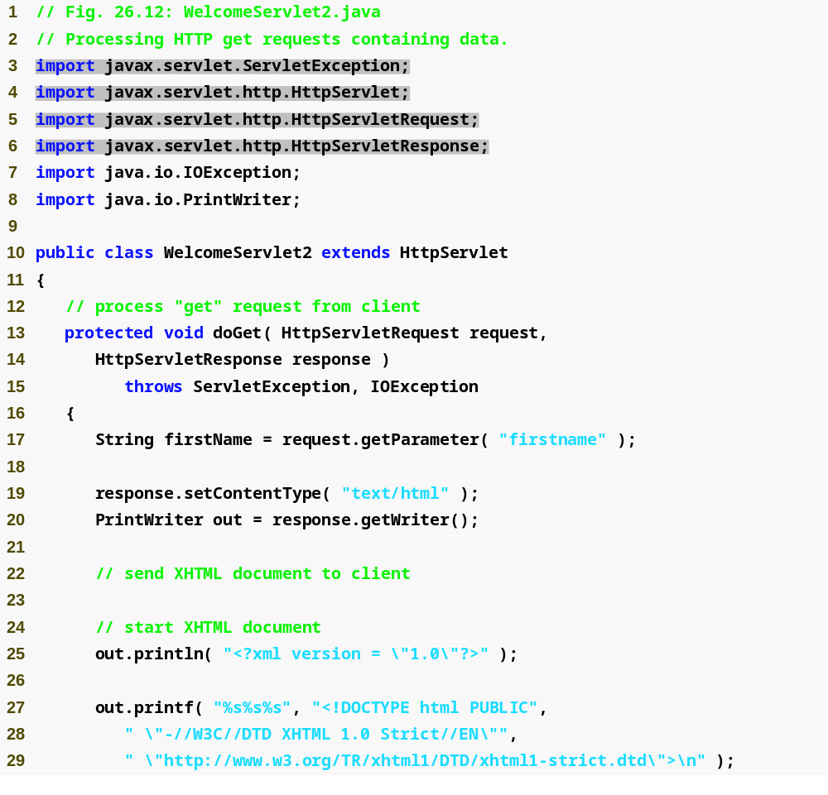
Outline
WelcomeServlet2.java
  (1 of 2)
  Line 17
The request object’s getParameter method receives the parameter name and returns the corresponding String value

Slide 45
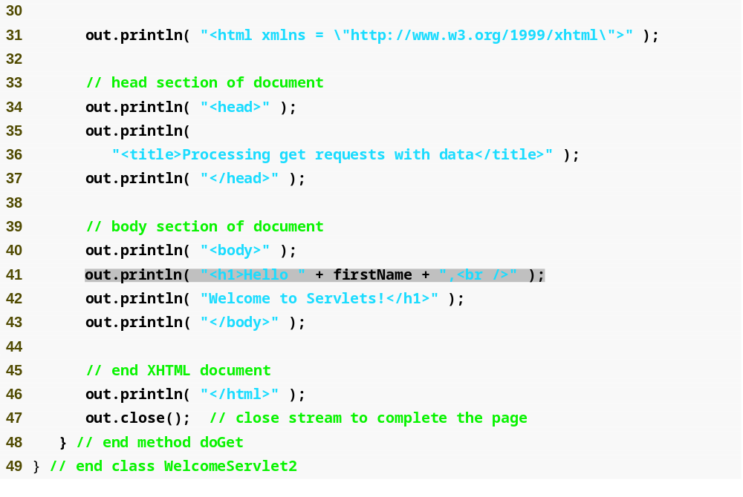
Outline
WelcomeServlet2.java
  (2 of 2)
  Line 41
Uses the result of line 17 as part of the response to the client

Slide 46
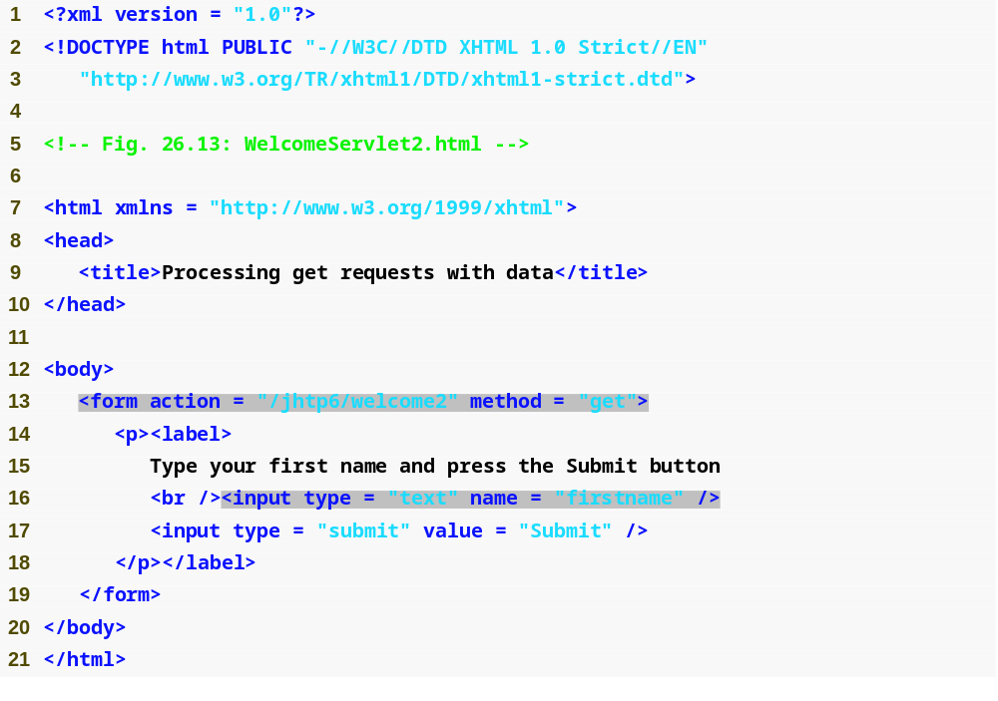
Outline
WelcomeServlet2.html
  (1 of 2)
  Line 16
Get the first name from the user.

Slide 47
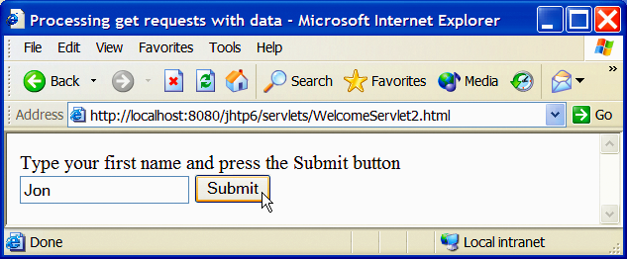
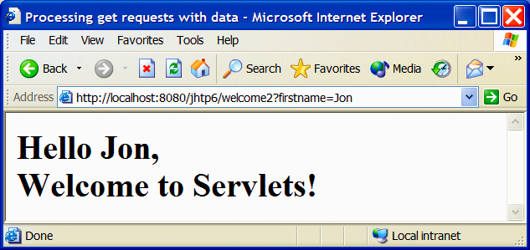
Outline
WelcomeServlet2.html
  (2 of 2)
  Program output
form data specified in URL’s query string as part of a get request

Slide 48
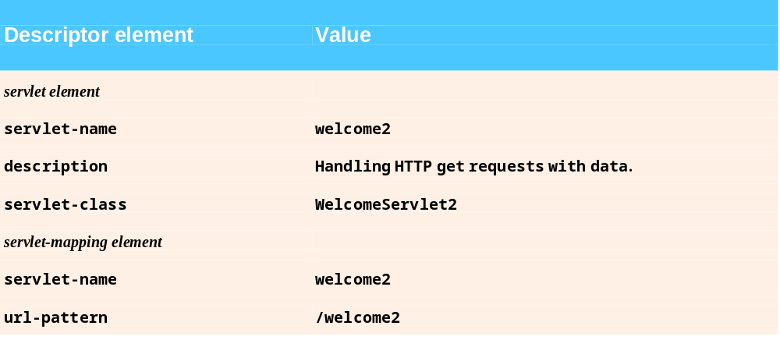
Fig. 26.14 | Deployment descriptor information for servlet WelcomeServlet2.

Slide 49
Error-Prevention Tip 26.4
If an error occurs during the servlet invocation, the log files in the logs directory of the Tomcat installation can help you determine the error and debug the problem.

Slide 50
Software Engineering Observation 26.4
A get request is limited to standard characters, which means that you cannot submit any special characters via a get request. The length of the URL in a get request is limited. For example, the maximum URL length in Internet Explorer is 2,083 characters. Some Web servers might restrict this even more.

Slide 51
Good Programming Practice 26.1
A get request should not be used for sending sensitive data (e.g., a password) because the form data is placed in a query string that is appended to the request URL as plain text and can be intercepted.

Slide 52
26.6 Handling HTTP post Requests
HTTP post request
  Post data from an HTML form to a server-side form handler
  Browsers cache Web pages
Servlet WelcomeServlet3
  Responds to a post request that contains data

Slide 53
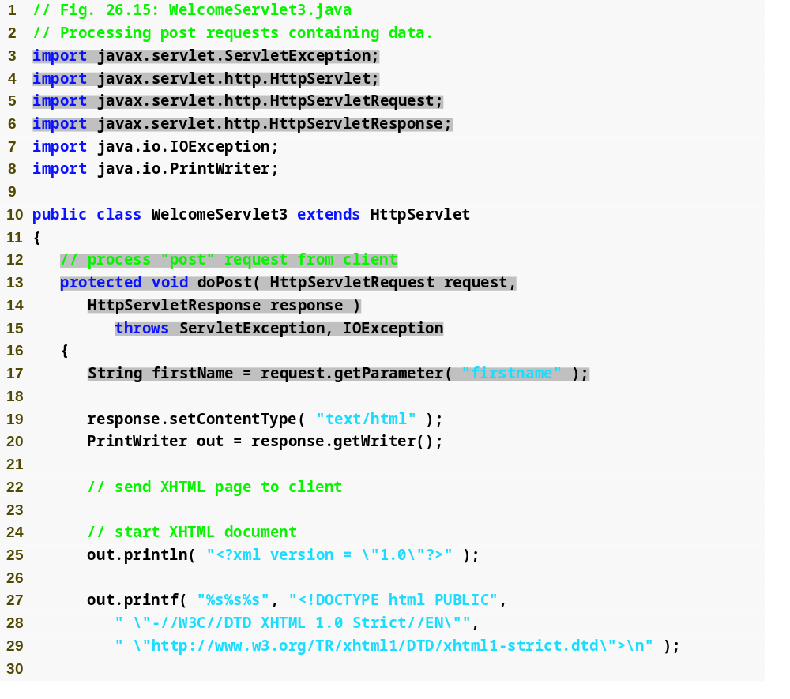
Outline
WelcomeServlet3.java
  (1 of 2)
  Lines 13-48
  Line 17
Declare a doPost method to responds to post requests
The request object’s getParameter method receives the parameter name and returns the corresponding String value

Slide 54
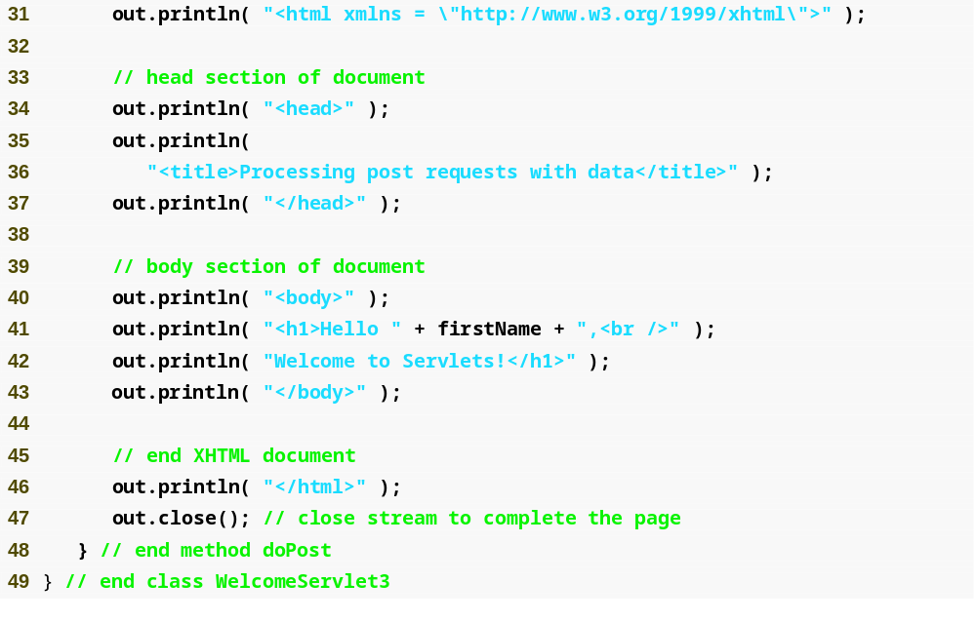
Outline
WelcomeServlet3.java
  (2 of 2)

Slide 55
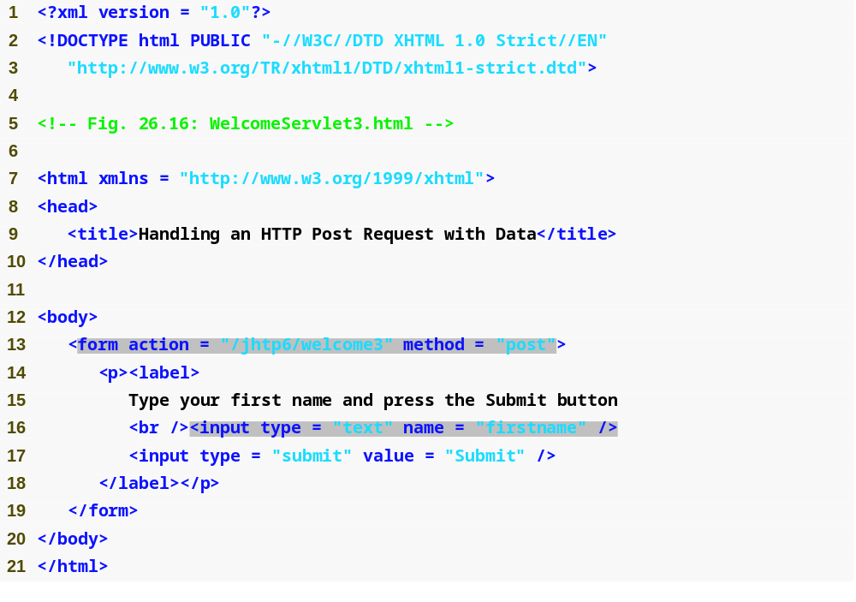
Outline
WelcomeServlet3.html
  (1 of 2)
  Lines 13-19
Provide a form in which the user can input a name in the text input element firstname, then click the Submit button to invoke WelcomeServlet3

Slide 56
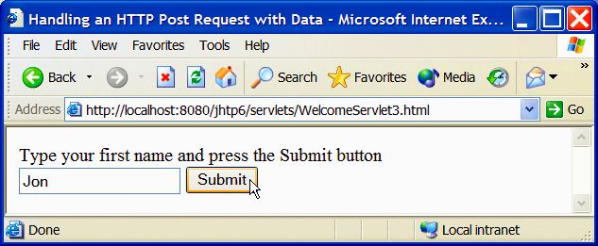
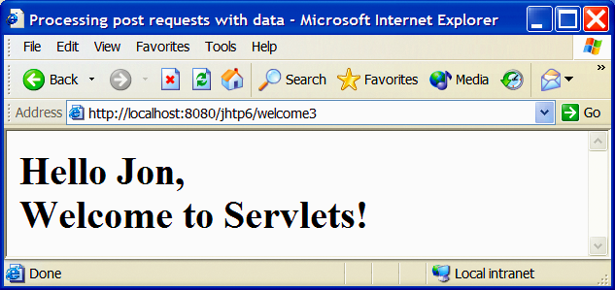
Outline
WelcomeServlet3.html
  (2 of 2)
  Program output

Slide 57
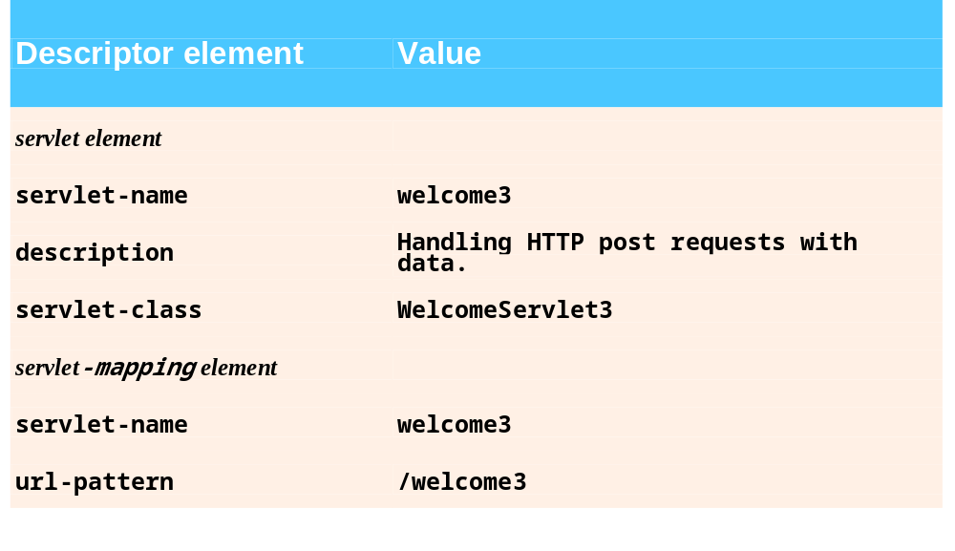
Fig. 26.17 | Deployment descriptor information for servlet WelcomeServlet3.

Slide 58
26.7 Redirecting Requests to Other Resources
Servlet RedirectServlet
  Redirects the request to a different resource

Slide 59
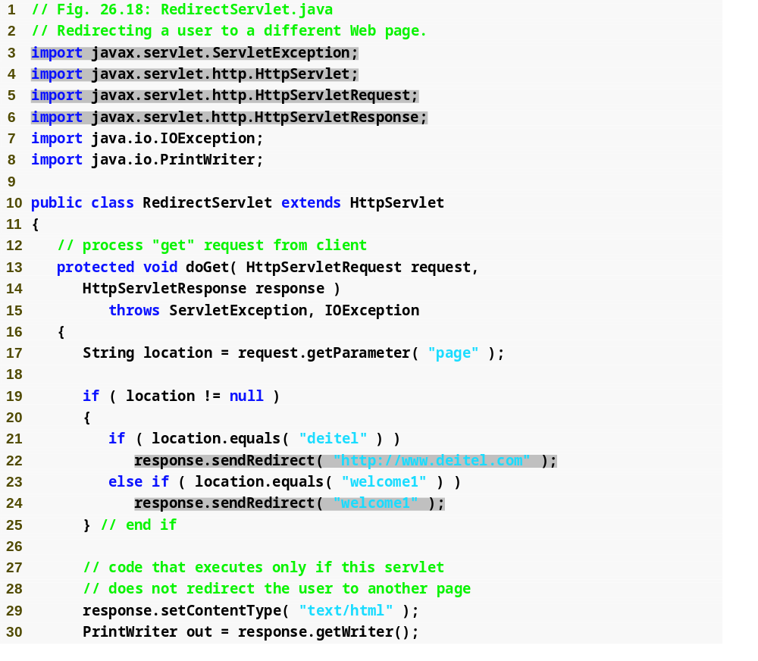
Outline
RedirectServlet.java
  (1 of 2)
  Line 17
  Lines 21 and 23
  Line 22
  Line 24
Obtains the page parameter from the request.
Determine if the value is either “deitel” or “welcome1”
Redirects the request to www.deitel.com.
Redirects the request to the servlet WelcomeServlet.

Slide 60
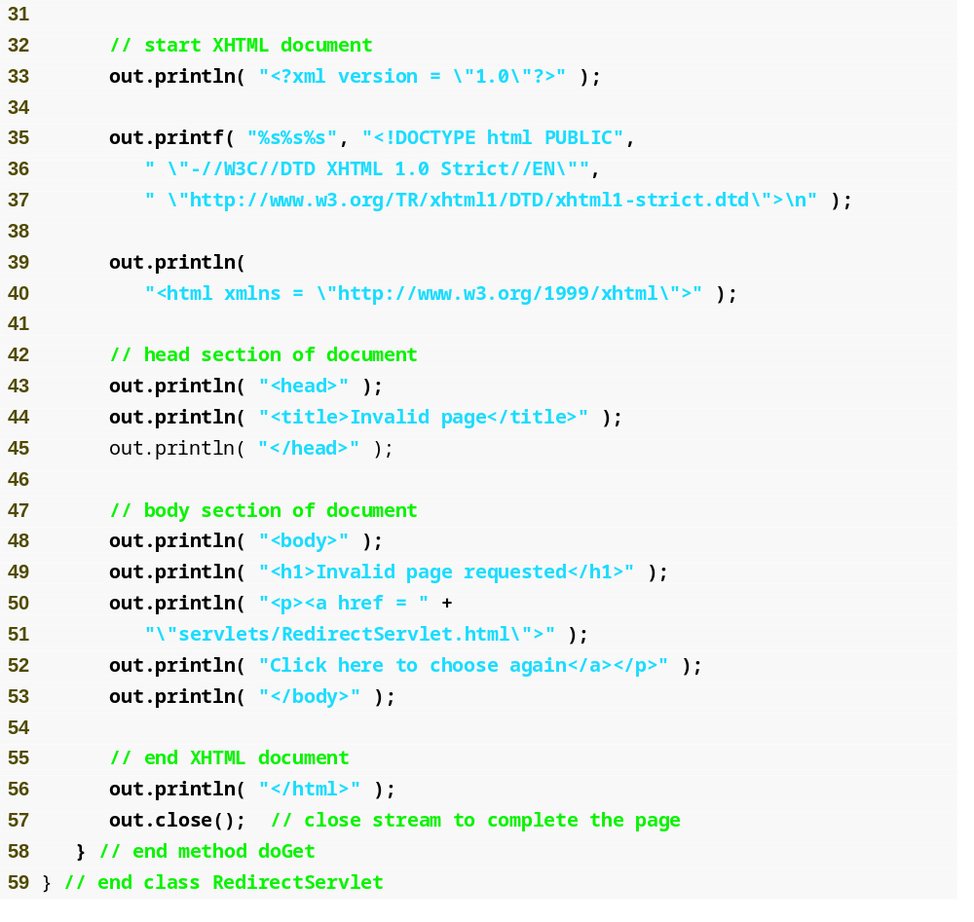
Outline
RedirectServlet.java
  (2 of 2)

Slide 61
Software Engineering Observation 26.5
Using relative paths to reference resources in the same context root makes your Web application more flexible. For example, you can change the context root without making changes to the static and dynamic resources in the application.

Slide 62
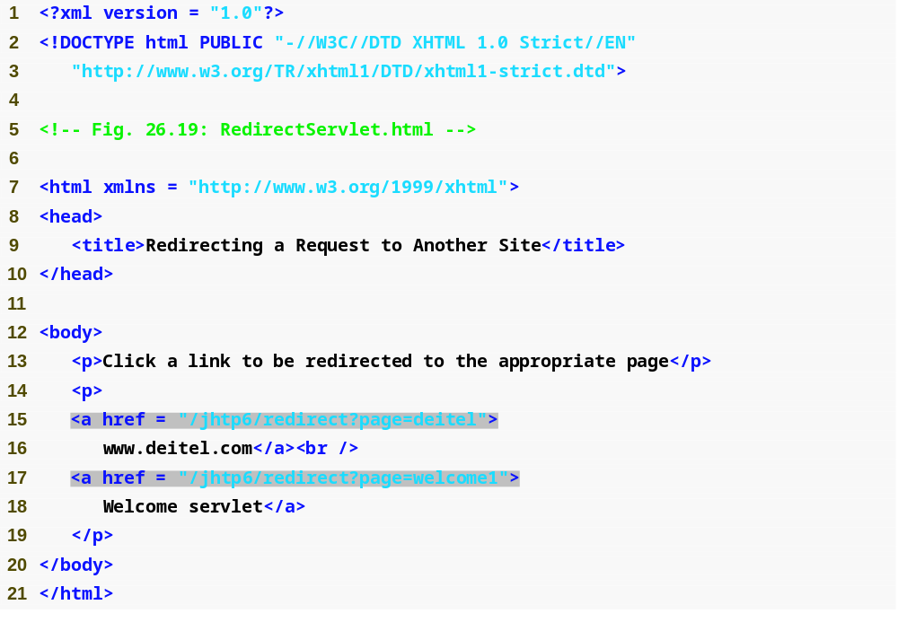
Outline
RedirectServlet.html
  (1 of 2)
  Lines 15-16 and 17-18
Provide links that allow the user to invoke the servlet RedirectServlet

Slide 63
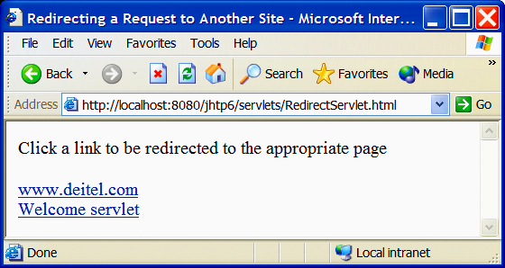
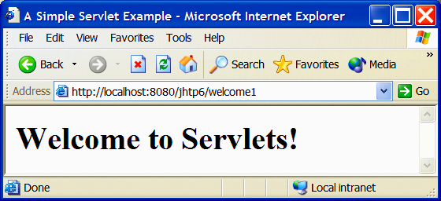
Outline
RedirectServlet.html
  (2 of 2)
  Program output

Slide 64
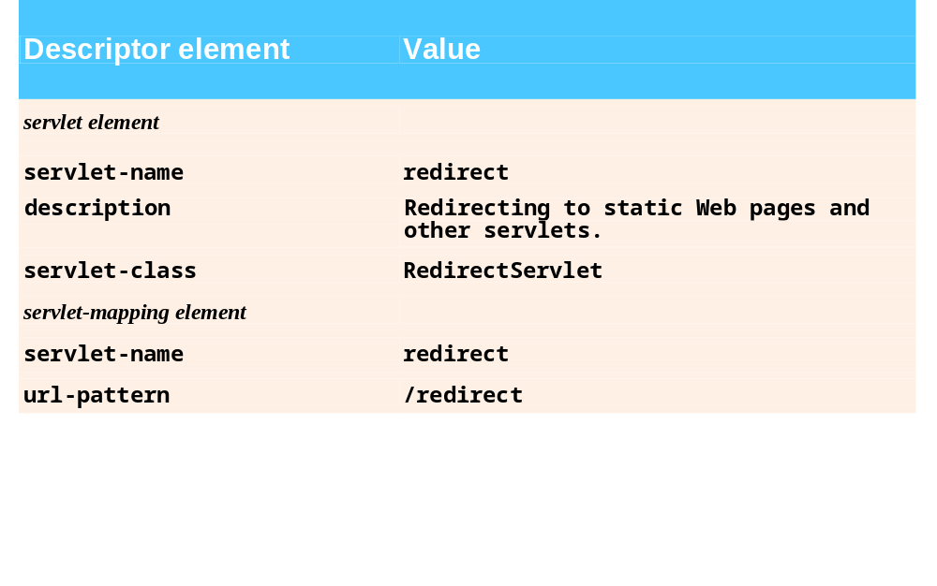
Fig. 26.20 | Deployment descriptor information for servlet RedirectServlet.

Slide 65
26.8 Multitier Applications: Using JDBC from a Servlet
Three-tier distributed applications
  User interface
  Business logic
  Database
Web servers often represent the middle tier
Three-tier distributed application example
  SurveyServlet
  Survey.html
  MySQL database

Slide 66
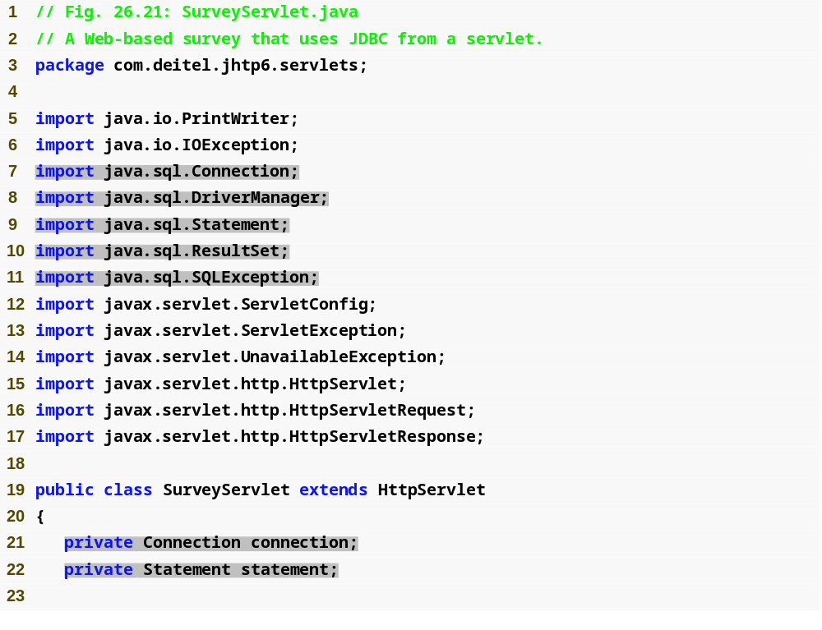
Outline
SurveyServlet.java
  (1 of 6)
  Lines 7-11
  Line 21
  Line 22
Import interfaces and classes for database manipulation
Declare a Connection to manage the database connection
Declare a Statement for updating the vote count, totaling all the votes and obtaining the complete survey result

Slide 67
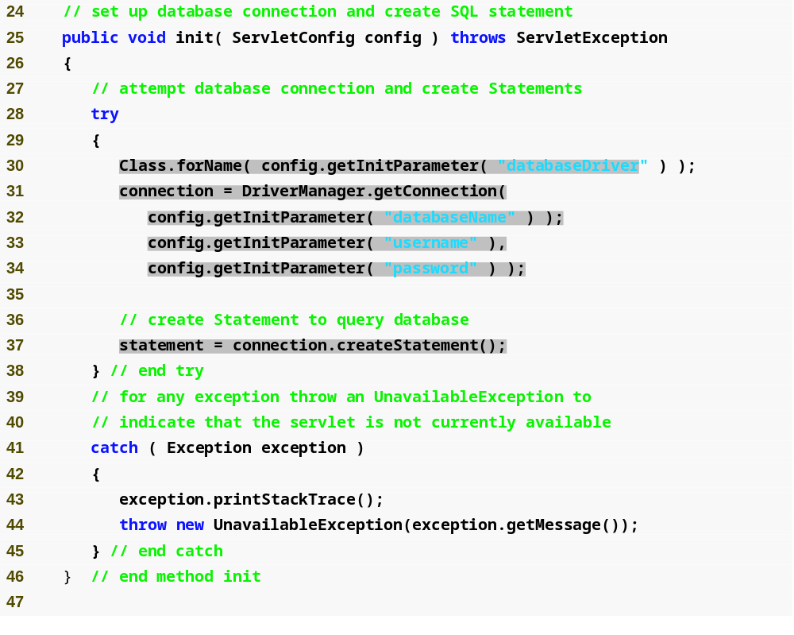
Outline
Loads the database driver, which is specified in the initialization parameter “databaseDriver”
SurveyServlet.java
  (2 of 6)
  Line 30
  Lines 31-34
  Line 37
Attempt to open a connection to the animalsurvey database, the database name, username and password are specified in the initialization parameters
Create Statement to query database.

Slide 68
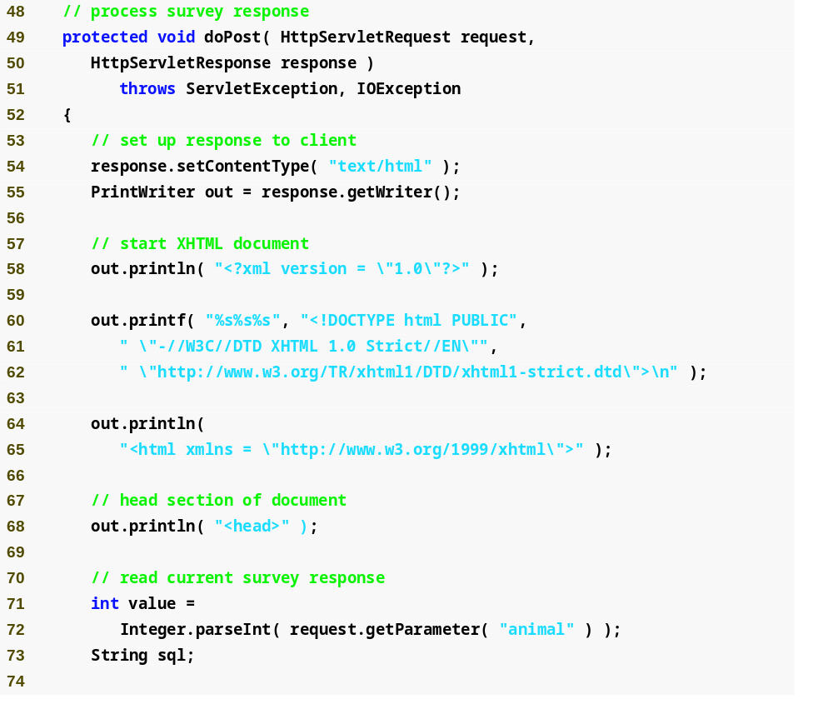
Outline
SurveyServlet.java
  (3 of 6)
  Lines 71-72
Obtain the survey response

Slide 69
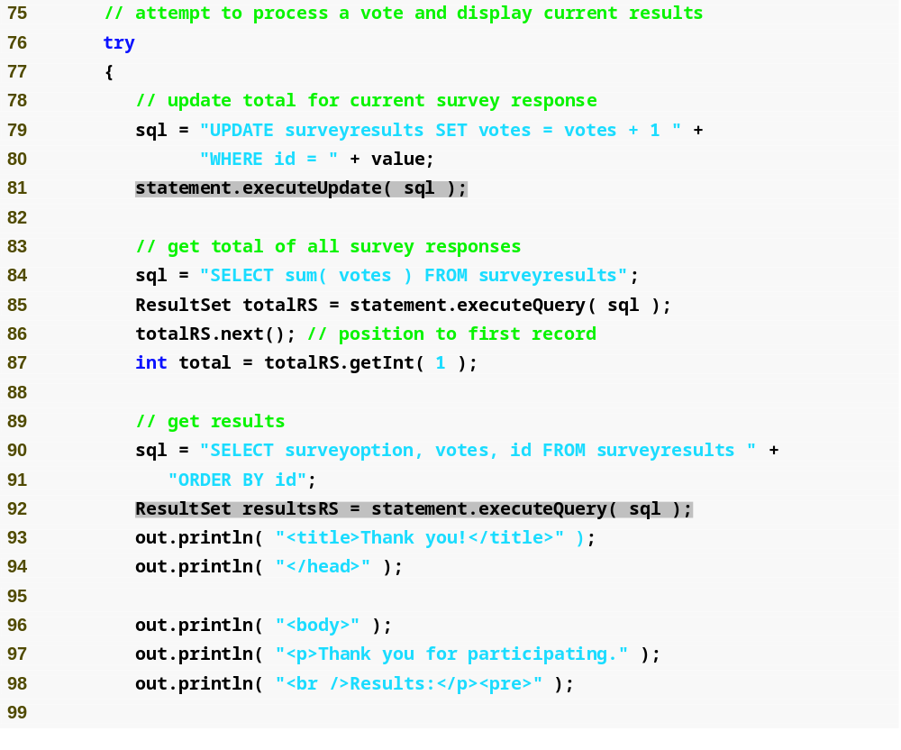
Outline
Create sql to update total for current survey response
Execute sql statement to update total for current survey response
SurveyServlet.java
  (4 of 6)
  Lines 79-80
  Line 81
  Line 84
  Line 85
  Lines 90-91
  Line 92
Create query to get total of all survey responses
Execute query to get total of all survey responses
Create query to get survey results
Execute query to get survey results

Slide 70
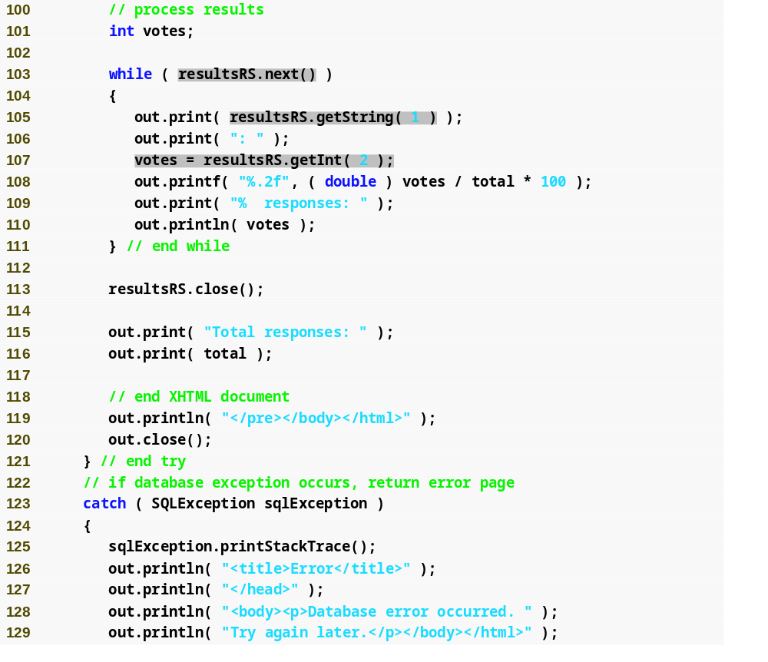
Outline
Loop through all records in resultsRS
Obtain the value of the first column from the current record
Obtain the value of the second column from the current record
SurveyServlet.java
  (5 of 6)
  Lines 103-111
  Line 105
  Line 107

Slide 71
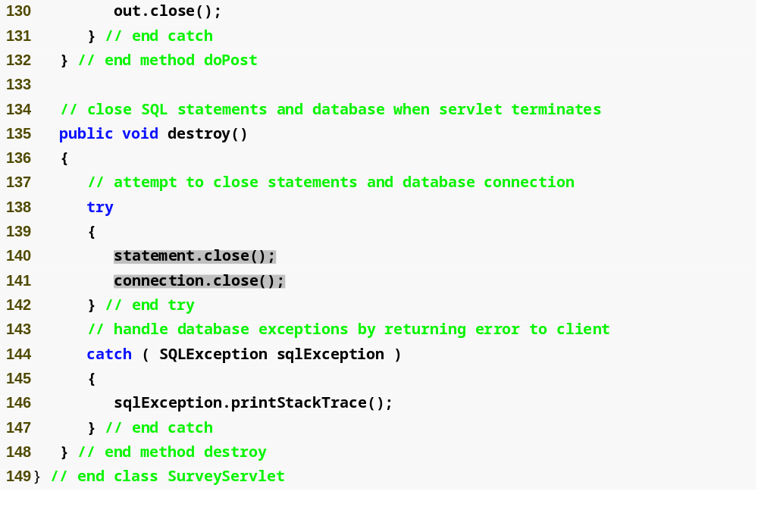
Outline
SurveyServlet.java
  (6 of 6)
  Lines 140-141
Close Statement and database connection

Slide 72
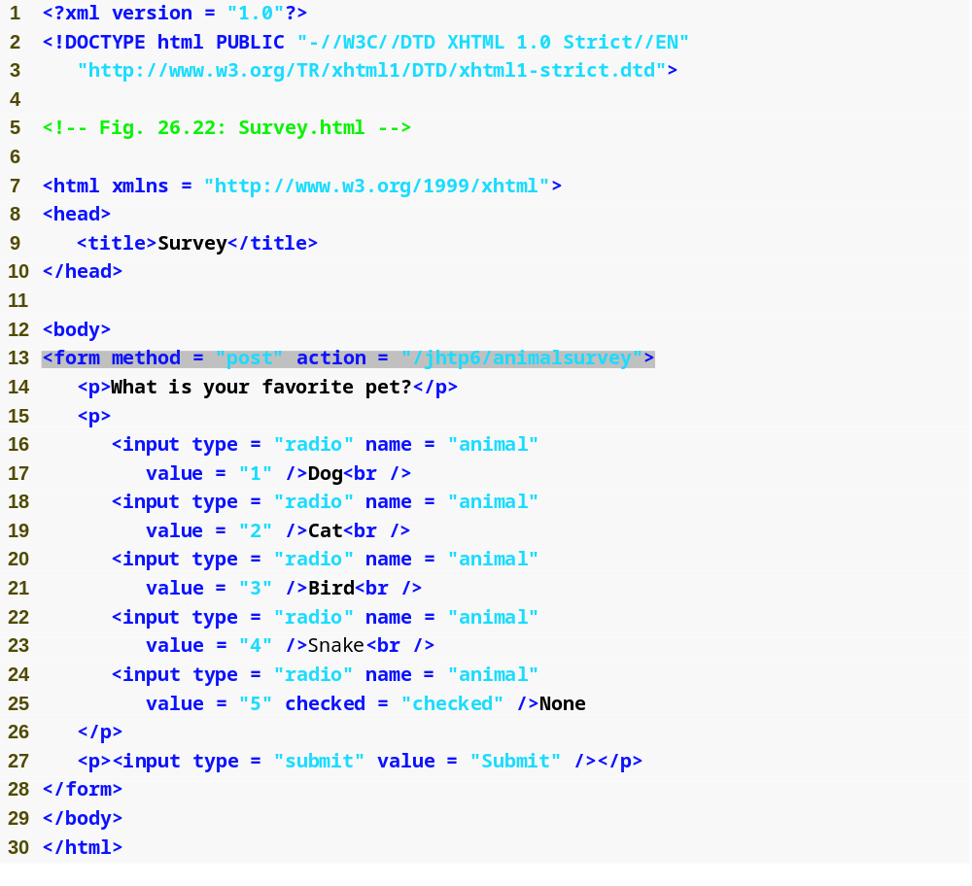
Outline
Survey.html
  (1 of 2)
Provide a form in which the user can select an animal from a list of radio button, then click the Submit button to invoke animalsurvey

Slide 73
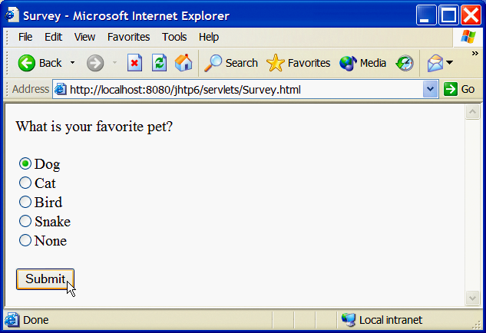
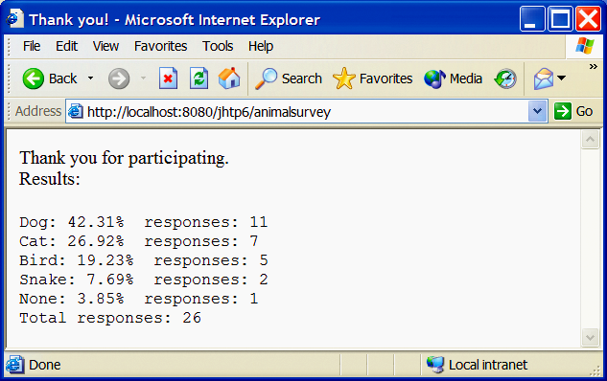
Outline
Survey.html
  (2 of 2)
  Program output

Slide 74
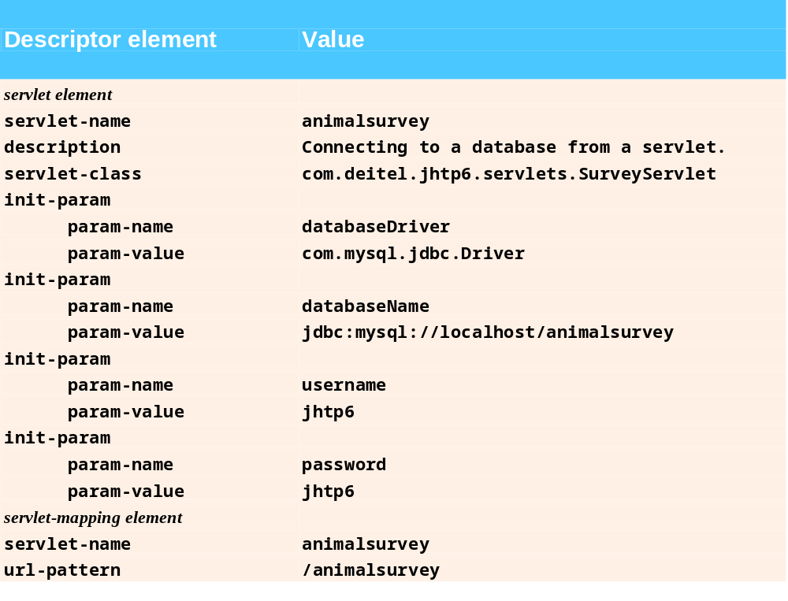
Fig. 26.23 | Deployment descriptor information for servlet SurveyServlet.

Slide 75
26.9 Welcome Files
Welcome files
  Ordered list of files
    HTML, JSP documents
  Loaded when the request URL is not mapped to a servlet
  Defined using the welcome-file-list element
    Contain one or more welcome-file elements
      Specify the partial URL of a welcome file
        Without a leading or trailing /
    E.g., specify index.html and index.htm as welcome files
    <welcome-file-list>
    <welcome-file>index.html</welcome-file>
    <welcome-file>index.htm</welcome-file>
    </welcome-file-list>

Slide 76
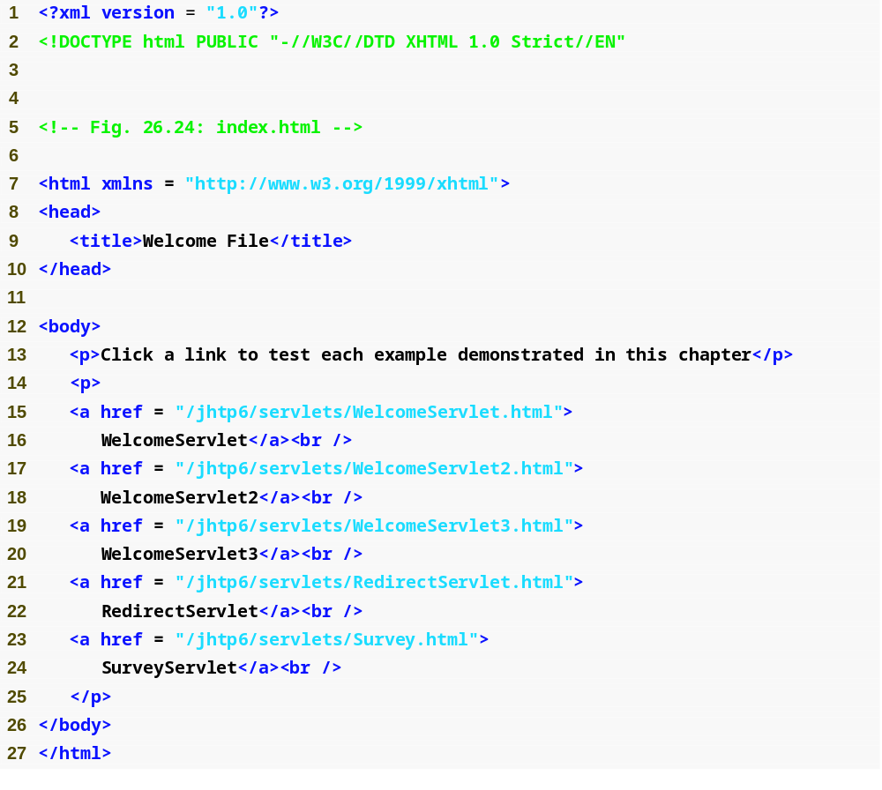
Outline
index.html
(1 of 2)
Lines 15-24
Provide links to test all the examples demonstrated in this chapter

Slide 77
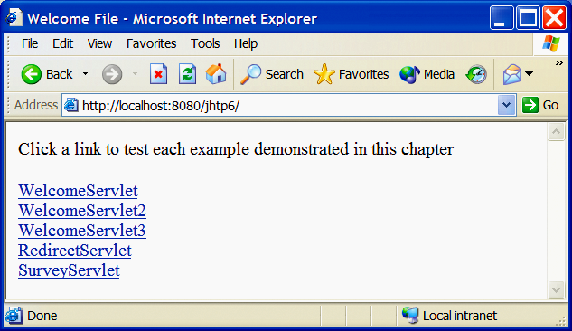
Outline
index.html
  (2 of 2)
  Program output

